Slide 1
Local workforce Development Boards
Locally-driven system focused on meeting local needs and priorities
December 7, 2016

Slide 2
Workforce Investment Network for Maryland (WIN)
An association of the 12 Workforce Directors in Maryland
Meet monthly
Collaborate with DLLR and other state workforce partners
Foster regional and state-wide collaboration and best practices
Advocate for the public workforce system
Provide training for the workforce system in Maryland
Promoting the success of Maryland’s workforce system

Slide 3
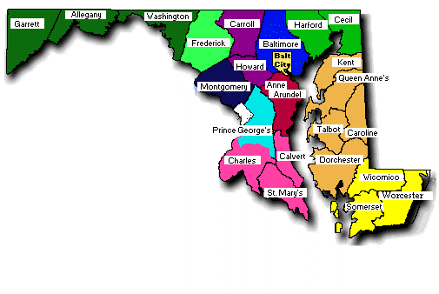
Local Workforce Investment areas

Slide 4
Businesses on Maryland’s Local Boards
Carroll Hospital at LifeBridge Health
Canam Steel
Coherent Technical Services Inc. (CTSi)
CVS/Caremark
Express Employment
HunterDouglas
K. Neal Truck & Bus Center
Maryland Live!
Maryland Plastics, Inc.
McCormick
McCready Health
MedImmune
Medisolv
Meritus Health
National Security Agency (board liaison)
Pepco Holdings
PNC Bank
Sysco
SMECO
T Rowe Price
ThermoFisher
Wells Fargo Bank
Whiting-Turning Contracting
W.L. Gore

Slide 5
Role and Purpose of The Local Boards
Represents a wide variety of individuals, businesses, and organizations throughout the local area
Serves as a strategic convener to promote and broker effective relationships between the CEOs and economic, education, and workforce partners
Develop a strategy to continuously improve and strengthen the workforce development system
Improve employment, training, and education outcomes for workforce system customers through innovation and alignment
Notes:
The difference is – the board does not deliver services – the board hires organizations like Howard County Workforce to deliver the services
The board is the strategic planner and oversight

Slide 6
Role and Purpose of The Local Boards
All members actively participate and collaborate closely with the required and other partners of the workforce system
Integrates and aligns a more effective job-driven system
Provides strategic and operational oversight in collaboration with required and other partners
Assists in the achievement of the state’s strategic and operational vision and goals
Maximizes and continues to improve the quality of services, customer satisfaction, and effectiveness of the services provided

Slide 7
Meeting local need
Determine which industries to target
Guide services to target populations in the local area
Source additional funding for strategic priorities
Validate labor market data
Engage businesses to provide solutions to workforce problems
Facilitate the development of career pathways
Ambassadors and advocates of the public workforce system
Develop innovative ways to bridge the skills gap and address workforce barriers
Establish industry sector partnerships

Slide 8
Questions?

